Slide 1
This is what we want to emulate
http://www.axsmarine.com/public/files/AXSDry_Product%20Information.pdf

Slide 2
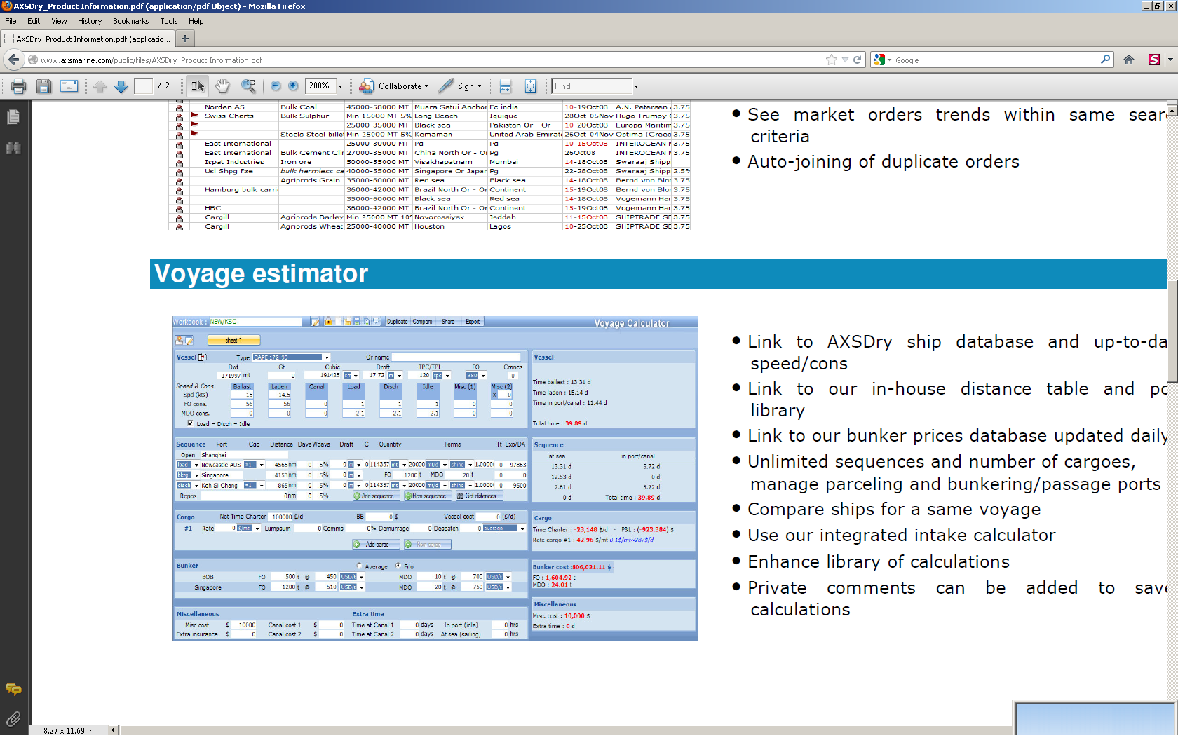
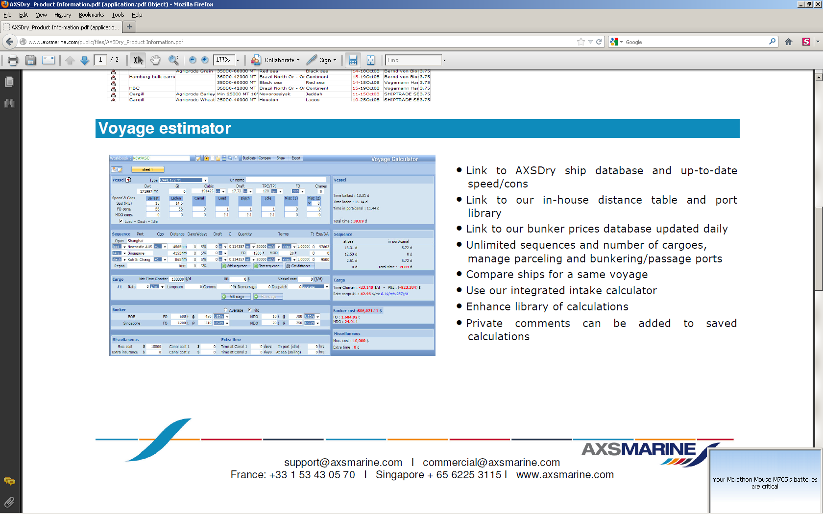
Voyage Estimator

Slide 3
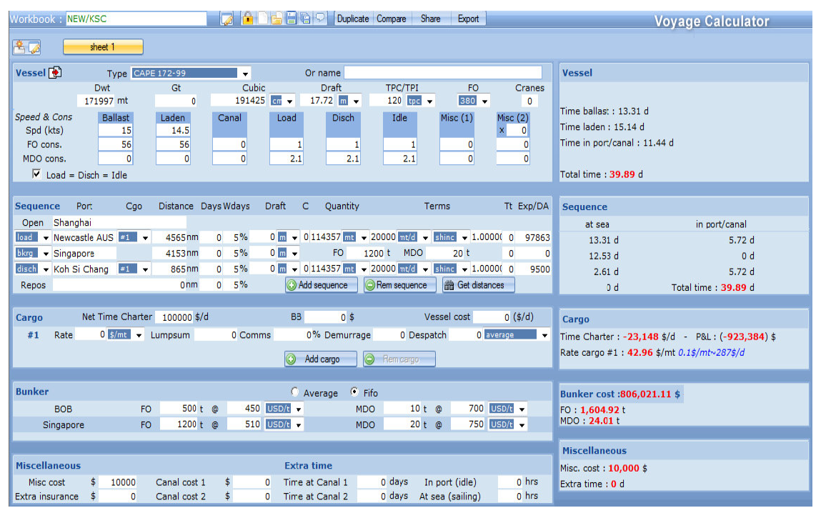
So here are the fields
Ship Name populates data to the following fields:-
DWT
Calculates Cubic
Speed
Draft
Cranes
See ADD Sequence to repeat the process
See ADD Cargo

Slide 4
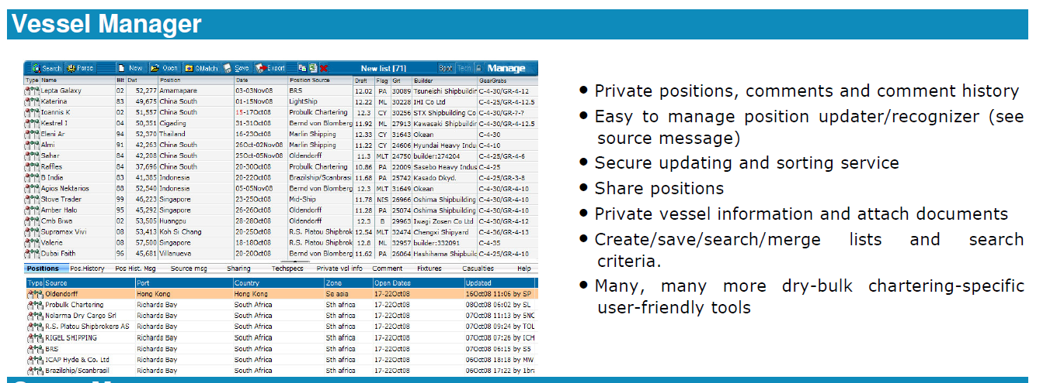
Vessel Manager

Slide 5
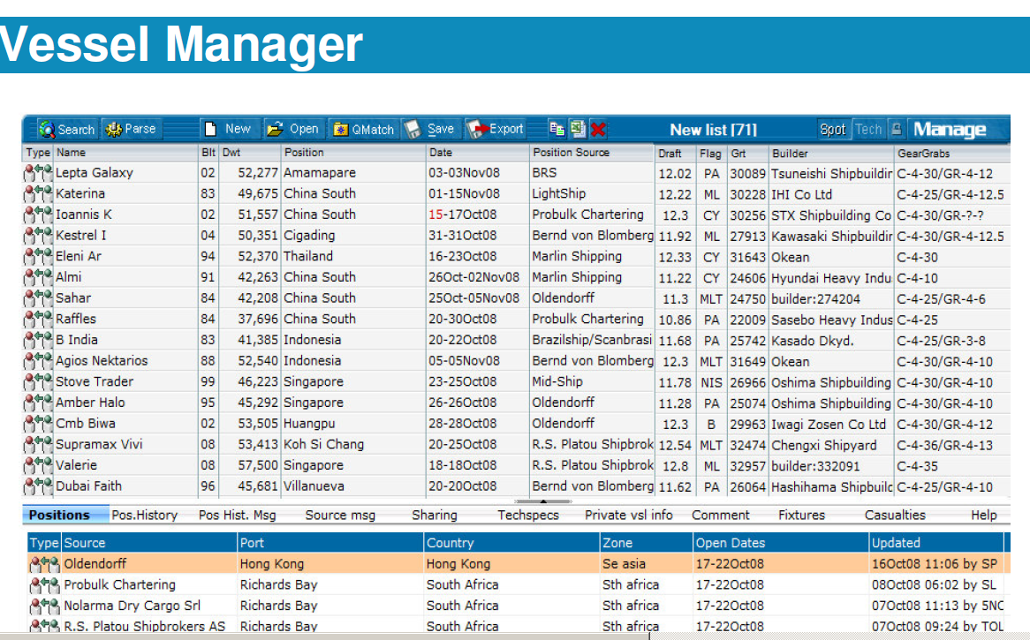
Ship Name
Built
DWT
Draft
Gross Tonnage Builder Gears/Grabs

Slide 6
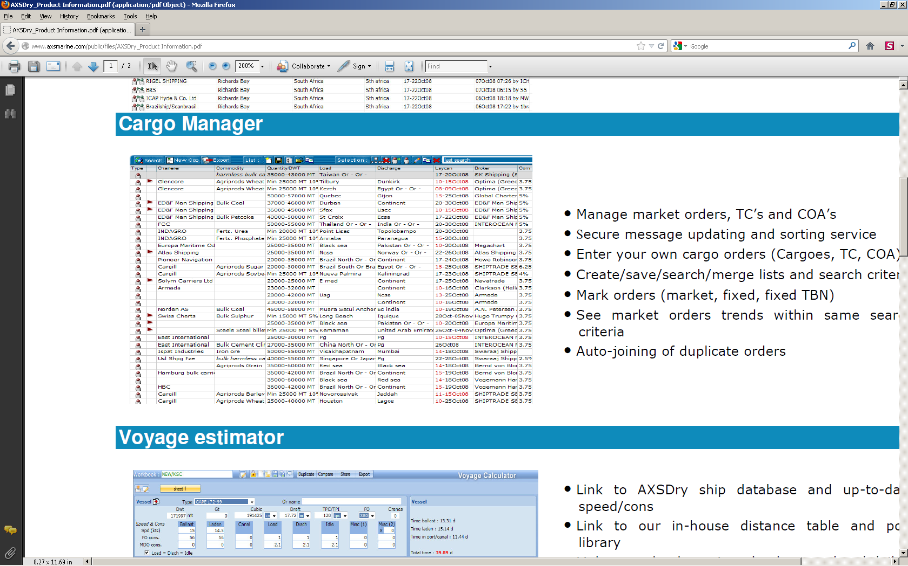
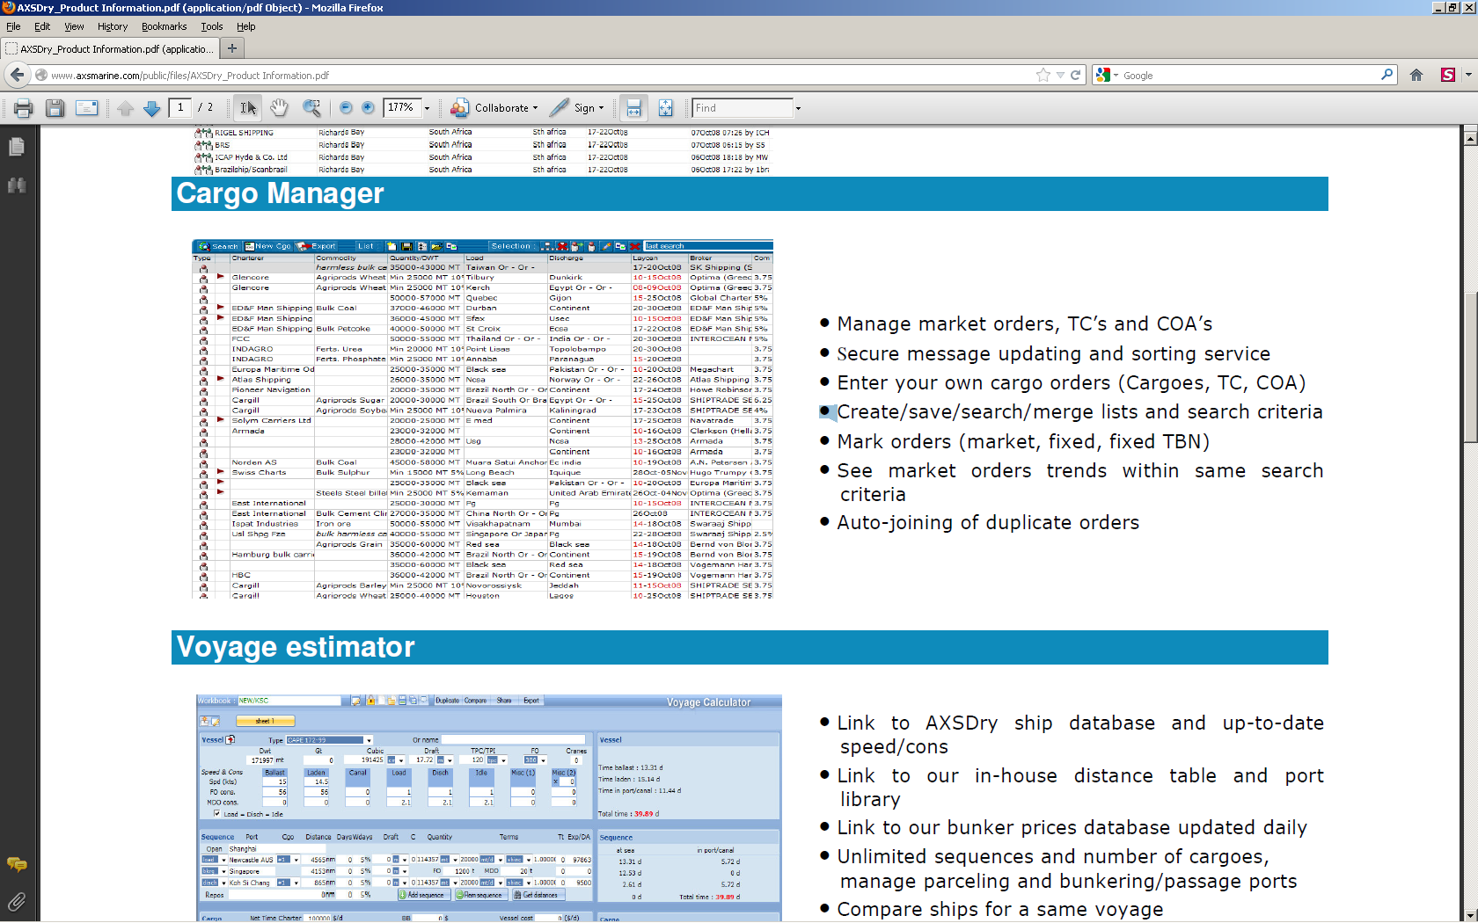
Cargo Manager

Slide 7
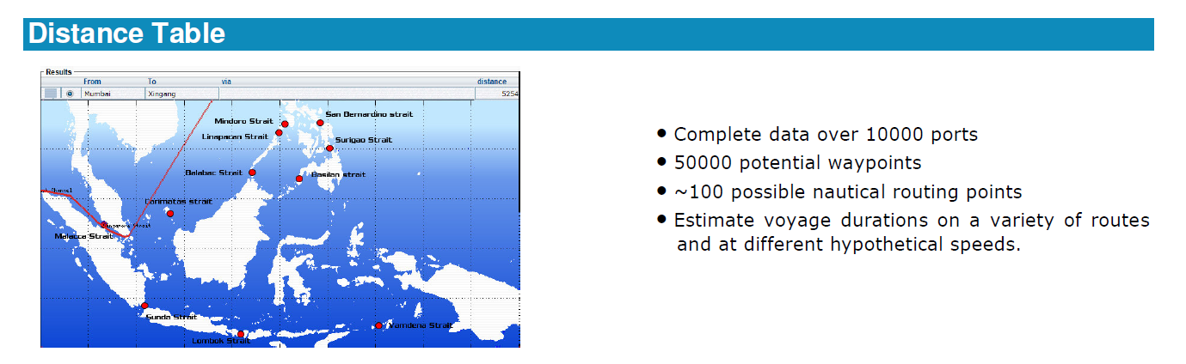
Distance Tables

Slide 8
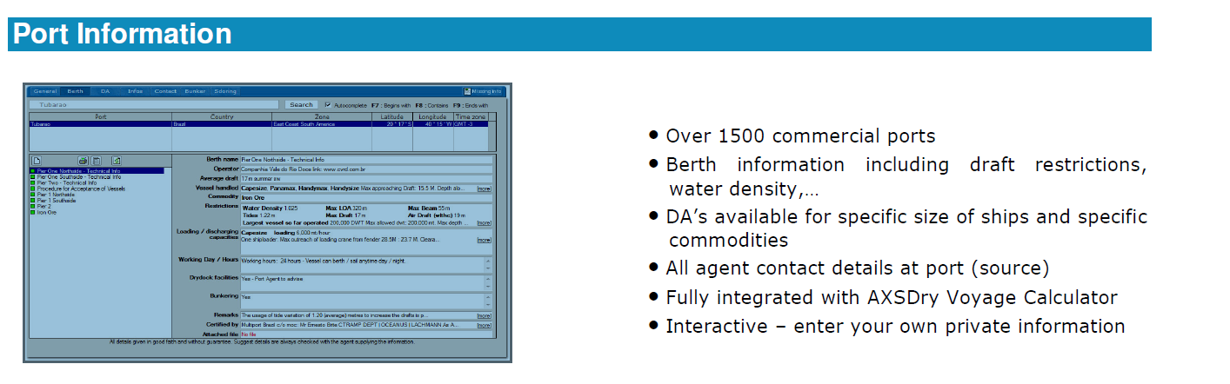
Port Information

Slide 9
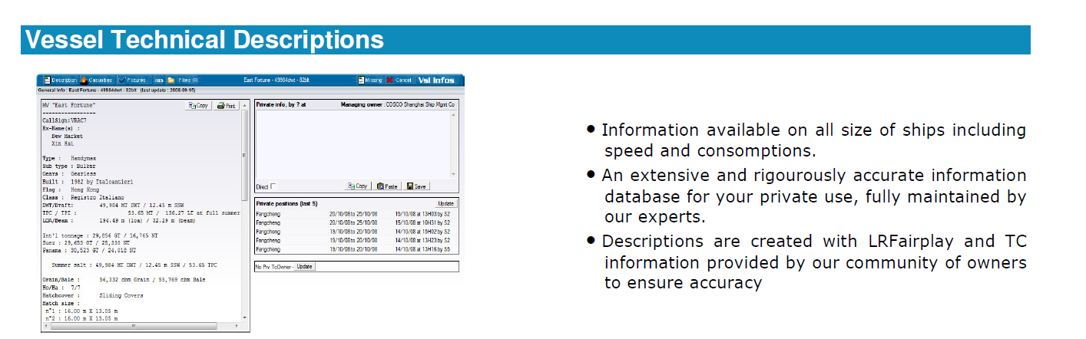
Vessel Technical Description

Slide 10
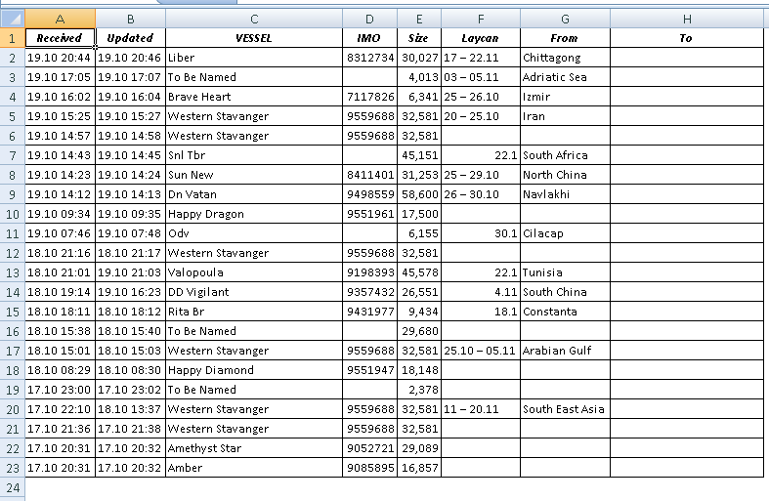
Position XLS from CS

